Slide 1
Data Wrangling Data Scraping
STAT 7500 – Statistical Programming

Slide 2
Overview of Data Wrangling
Isolating data – filter, select, and arrange
Piping operator – %>%
Deriving information – summarize, group_by, mutate
Combining datasets – bind_row and joins
Tidy data – pivot_longer, pivot_wider
Working with strings – stringr
Scraping data – rvest
Notes:
Change this on previous lectures…

Slide 3
Data Scraping (from the Internet)
Reference a file on the internet
Download a file from the internet
Scrape a table from an HTML file
The selector gadget
Using Twitter’s Application Programming Interface (API)

Slide 4
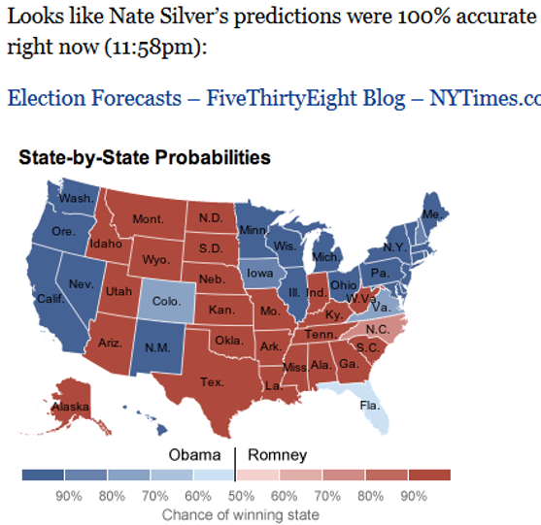
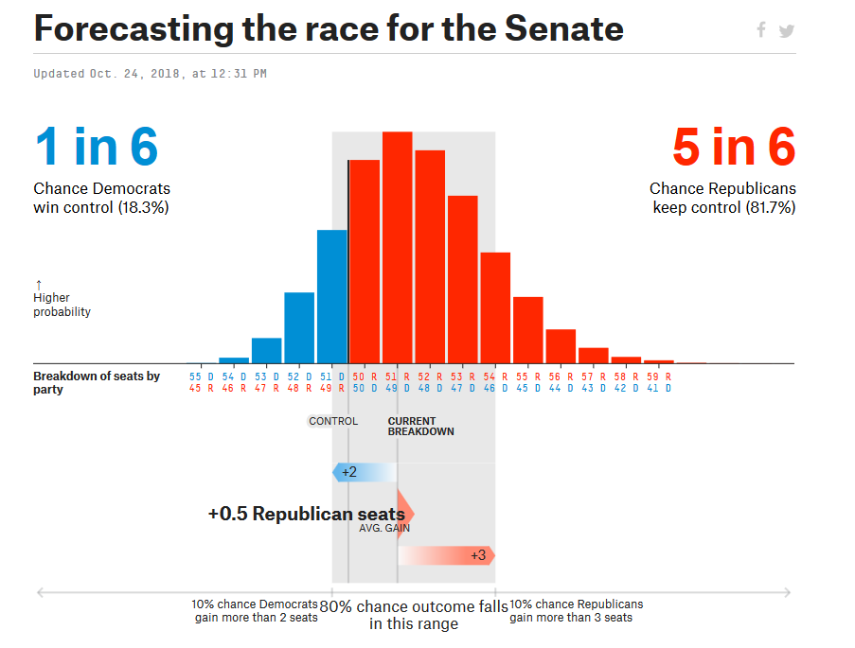

Fivethirtyeight.com
Nate Silver – Politics, Sports, and More

Slide 5
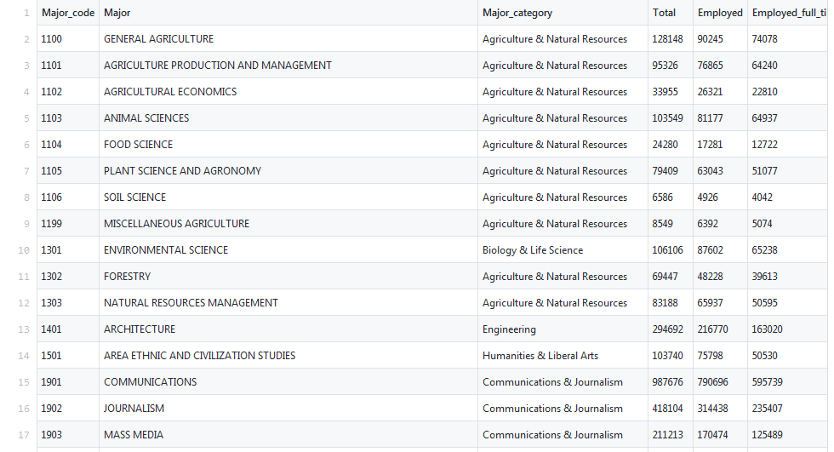
Fivethirtyeight Data
College Major data: https://github.com/fivethirtyeight/data/blob/master/college-majors/all-ages.csv

Slide 6
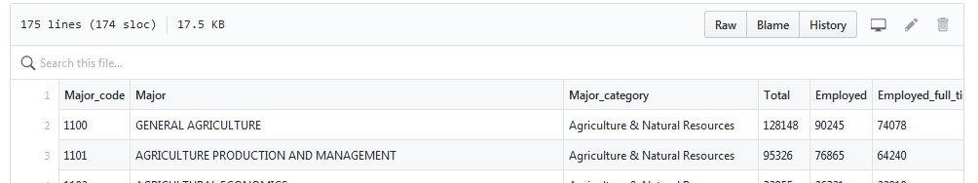
Reference a File on the Internet
We want to read in the actual csv file (for now)
Click on “raw” to get the raw csv file
collmaj538_file <- "https://raw.githubusercontent.com/fivethirtyeight/data/master/college-majors/all-ages.csv"
collmaj <- read_csv(collmaj538_file)

Slide 7
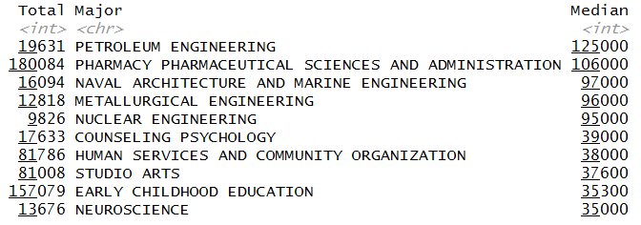
Explore the Data…Median Salary
collmaj %>%
select(Major,Median) %>%
arrange(desc(Median)) %>%
slice(c(1:5,(nrow(collmaj)-4):nrow(collmaj)))
Think about bias…

Slide 8
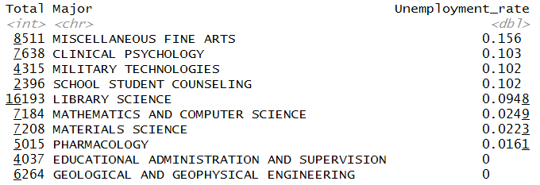
Explore the Data…Unemployment
collmaj %>%
select(Major,Unemployment_rate) %>%
arrange(desc(Unemployment_rate)) %>%
slice(c(1:5,(nrow(collmaj)-4):nrow(collmaj)))

Slide 9
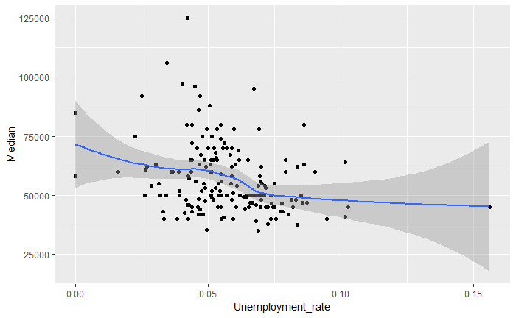
Explore the Data…Unemp vs. Median
ggplot(collmaj,aes(x=Unemployment_rate,y=Median)) +
geom_point() + geom_smooth()

Slide 10
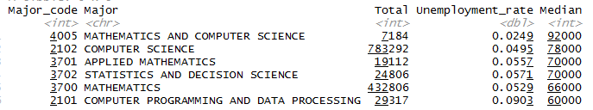
Explore the Data…Stat/CS-related
collmaj %>%
filter(Major_code %in% c(2101, 2102, 3700, 3701, 3702, 4005)) %>%
arrange(desc(Median)) %>%
select(Major_code, Major, Total, Unemployment_rate, Median)

Slide 11
Is this Good Coding?
Remove website or change structure -> It fails!
Change or update data on website -> Not reproducible!
Solution 1: Record the date which you ran the file
Sys.time()
Solution 2: Save the file locally…

Slide 12
Download a File from the Internet
Base R
collmaj538_file <- "https://raw.githubusercontent.com/fivethirtyeight/data/master/college-majors/all-ages.csv"
file_mycomp <- "collmaj538.csv“ (in the working directory)
download.file(collmaj538_file,file_mycomp)
See also RCurl package
Then the rest is the same as before…

Slide 13
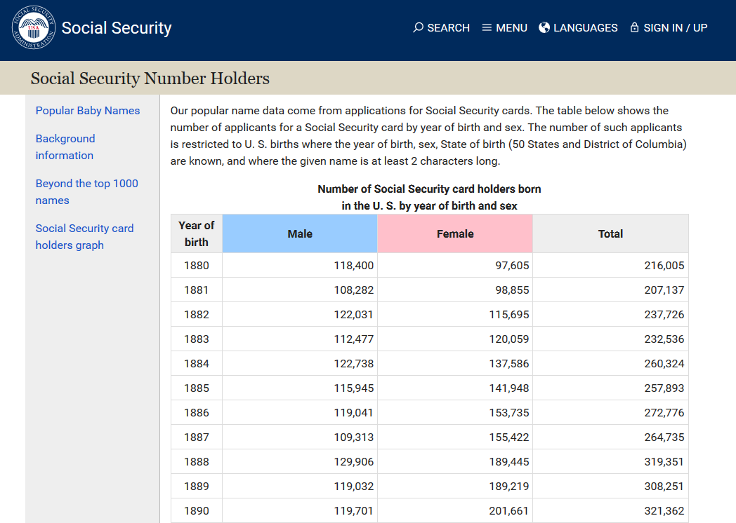
SSA – Birth File https://www.ssa.gov/oact/babynames/numberUSbirths.html

Slide 14
Scrape a table from an HTML file
Anatomy of HTML files - see w3schools (or DesignShack or Mozilla)
View source code – right-click (in most browsers)
Notes:
Go out and explore source code in HTML file. Take note of <table> tags, which is usually where the data are located.

Slide 15
Scrape a table from an HTML file
Anatomy of HTML files - see w3schools (or DesignShack or Mozilla)
View source code – right-click (in most browsers)
rvest package
Wrappers around xml2 and httr packages
Make it easy to download and manipulate HTML and XML files
HTML is Hypertext Markup Language - the language of web pages
XML is Extensible Markup Language - the programming language by which applications communicate over the internet
Notes:
http and ftp as well?

Slide 16
read_html() to read the file into R
birth_file <- "https://www.ssa.gov/oact/babynames/numberUSbirths.html"
birth_file %>%
read_html() # converts it to an XML document that can be read in

Slide 17
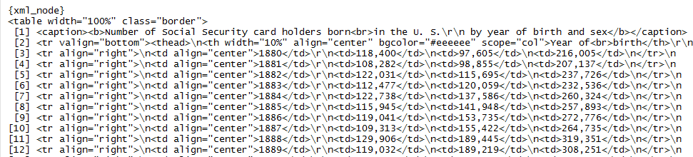
html_nodes() to identify objects
birth_file %>% read_html() %>%
html_nodes("table") finds the nodes that are tables
birth_file %>% read_html() %>% html_nodes("table") %>%
pluck(1) extracts first table

Slide 18
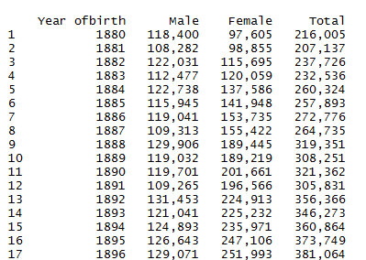

html_table() to Convert to Data Frame
birth_file %>% read_html() %>% html_nodes("table") %>% pluck(1) %>%
html_table() makes it into a data.frame
Whew!
A much more
familiar format!

Slide 19
Summary - Read in SSA Birth Table
birth_file <- "https://www.ssa.gov/oact/babynames/numberUSbirths.html"
birth_file %>%
read_html() %>% # reads it in as HTML
html_nodes("table") %>% # finds the table tags
pluck(1) %>% # extracts first table
.[[1]] %>% # old code
html_table() # converts it to a data.frame
as_tibble() # old code

Slide 20
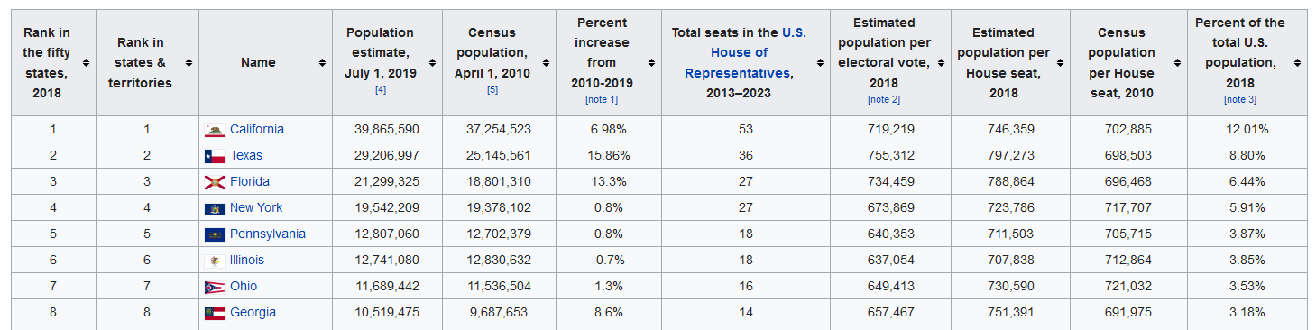
Another example: Mapping State Population
https://simple.wikipedia.org/wiki/List_of_U.S._states_by_population

Slide 21
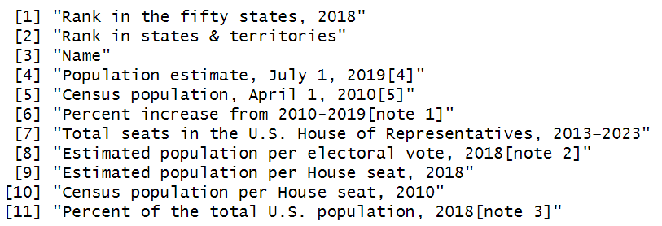
Reading File into R
statepop_file <- "https://simple.wikipedia.org/wiki/List_of_U.S._states_by_population"
statepop_file %>%
read_html() %>% html_nodes("table") %>% pluck(1) %>%
html_table() %>% names()
statepop <- statepop_file %>%
read_html() %>%
html_nodes("table") %>%
pluck(1) %>%
html_table() %>%
select(3,4,8)
names(statepop) <- c("state","pop_2019", "pop_per_electoral_vote")

Slide 22
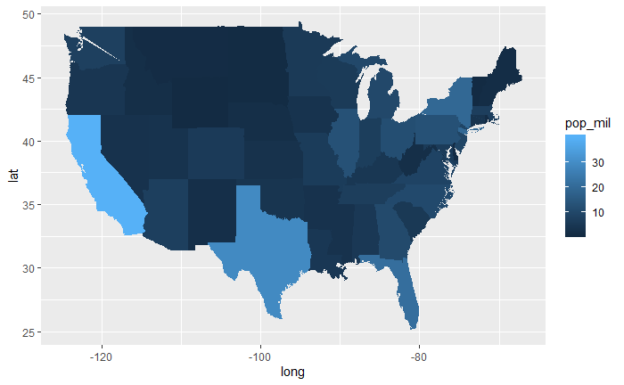
Making the Population Map
library(maps)
states <- map_data(“states”)
statepop %>%
mutate(state = str_to_lower(state)) %>%
right_join(states,by=c("state"="region")) %>%
mutate(pop = as.numeric(str_remove_all(pop_2019,",")),
pop_mil = round(pop / 1000000,1)) %>%
ggplot() +
geom_polygon(aes(long,lat,fill=pop_mil,
group=state))

Slide 23
Announcements – 12/10
Review
Combining Data – bind_rows and join
Scraping Data – URL %>% read_html() %>% html_nodes("table") %>%
pluck(?) %>% html_table()
Today
CATS and Review HW#5
Finish Scraping Data
Tidy Data
Working with Strings?
Upcoming
12/17 (optional) – RDW Project Due, Working with Strings, Ethics, Simulation/Bootstrap, Parting thoughts

Slide 24
Exercise - 2019 PSSA Data from PDE
PDE = Pennsylvania Department of Education. Their website is at www.education.pa.gov
PSSA is the Pennsylvania System of School Assessment
Measures student achievement “according to Pennsylvania's world-class academic standards”
“By using these standards, educators, parents and administrators can evaluate their students' strengths and weaknesses to increase students' achievement scores”
Subjects - reading, mathematics, science & writing
Scored as “Below Basic”, “Basic”, “Proficient” or “Advanced” (sometimes the latter two categories are combined)
Replaced by the Keystone exams which are required for graduation
…or maybe not!
Notes:
Start here on 12/10/24

Slide 25
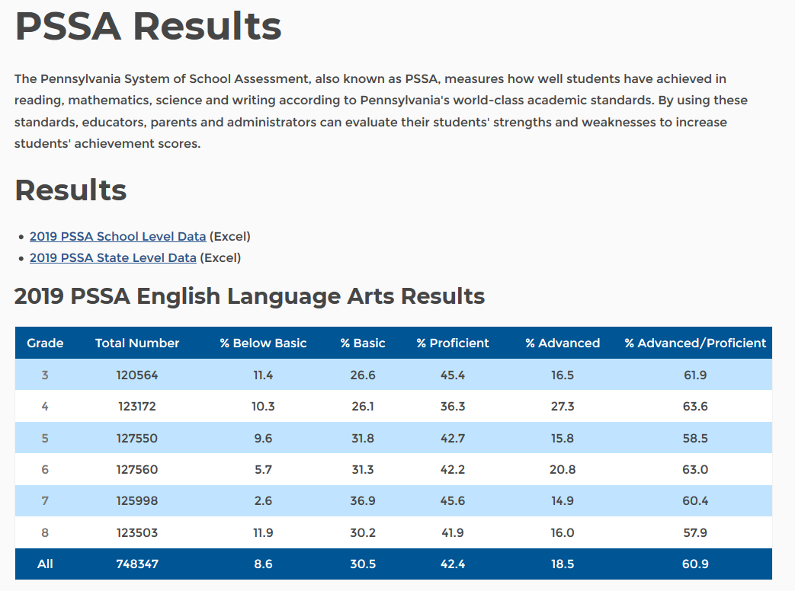
https://www.education.pa.gov/DataAndReporting/Assessments/Pages/PSSA-Results.aspx

Slide 26
PSSA Exercise
library(rvest)
pssa_2019_url <-
"https://www.education.pa.gov/DataAndReporting/Assessments/Pages/PSSA-Results.aspx"
Sys.time()
download.file(pssa_2019_url,"pssa_2019.html")
pssa_2019_file <- "pssa_2019.html"
Notes:
3/27/19 – start here, give time to work

Slide 27
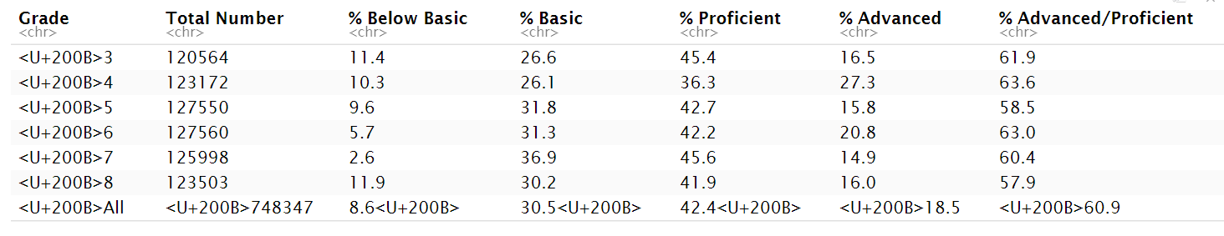
PSSA - ELA Scores
pssa_2019_file %>%
read_html() %>%
html_nodes("table") %>%
pluck(1) %>% # ELA is the first table
html_table() -> pssa_ela

Slide 28
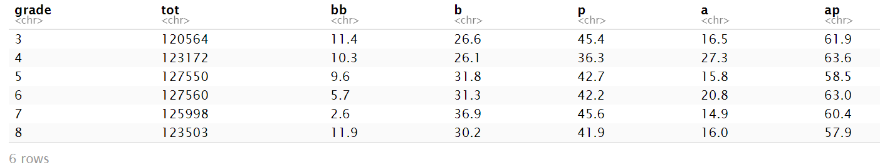
PSSA - Correcting ELA
names(pssa_ela0) <- c("grade","tot","bb","b","p","a","ap")
pssa_ela <- pssa_ela0 %>%
mutate(grade = str_sub(grade,-1)) %>% # strip off the last character
filter(grade != "l") # remove the totals

Slide 29
PSSA - Combining All
pssa_2019_file %>% read_html() %>% html_nodes("table") %>%
pluck(1) %>% html_table() %>% as_tibble() -> pssa_ela0
names(pssa_ela0) <- c("grade","totnum","bb","b","p","a","ap")
pssa_2019_file %>% read_html() %>% html_nodes("table") %>%
pluck(2) %>% html_table() %>% as_tibble() -> pssa_math0
names(pssa_math0) <- c("grade","totnum","bb","b","p","a","ap")
pssa_2019_file %>% read_html() %>% html_nodes("table") %>%
pluck(3) %>% html_table() %>% as_tibble() -> pssa_sci0
names(pssa_sci0) <- c("grade","totnum","bb","b","p","a","ap")

Slide 30
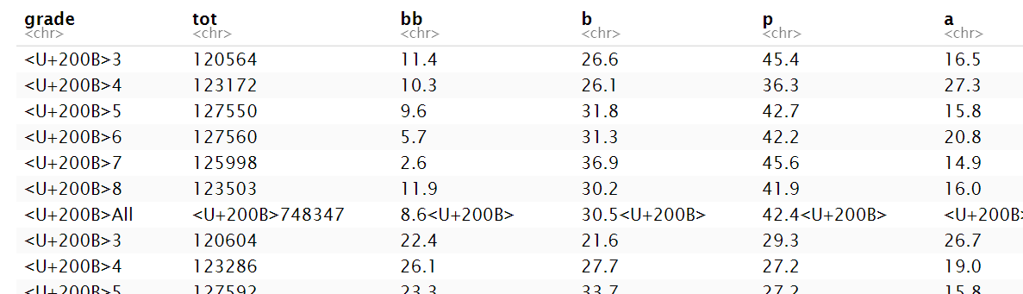
PSSA - Combining All
pssa0 <- bind_rows(pssa_ela0, pssa_math0, pssa_sci0)

Slide 31
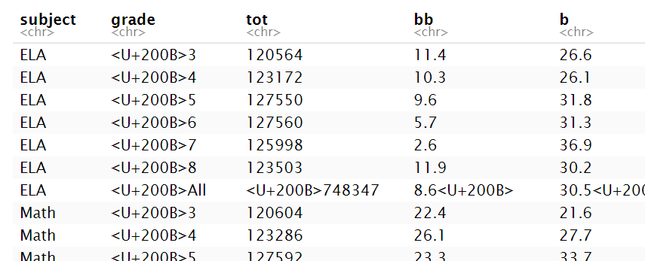
PSSA - Combining All Scores 2
pssa0 <- bind_rows("ELA" = pssa_ela0, "Math" = pssa_math0,
"Sci" = pssa_sci0, .id="subject")

Slide 32
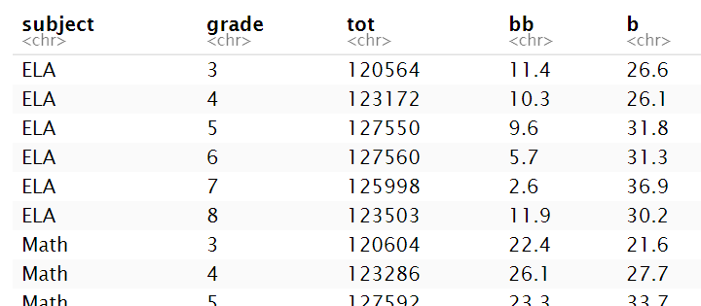
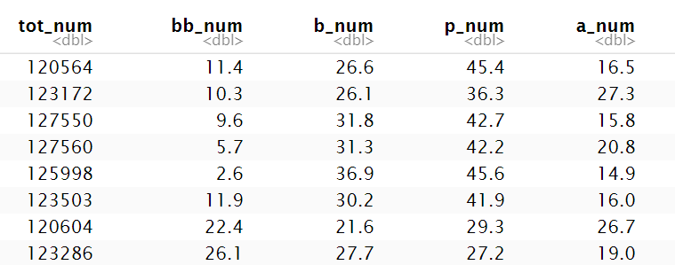
PSSA - Combining Scores
pssa <- pssa0 %>%
mutate(grade = str_sub(grade,-1)) %>% # strip off last character
filter(grade != "l") %>% # remove the totals
mutate(tot_num = as.numeric(tot),
bb_num = as.numeric(bb),
b_num = as.numeric(b),
p_num = as.numeric(p),
a_num = as.numeric(a),
ap_num = as.numeric(ap),
grade_num = as.numeric(grade))

Slide 33
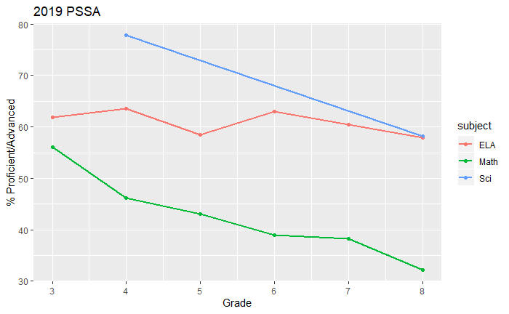
PSSA – Graph 1
pssa %>%
ggplot(aes(grade_num, ap_num, color=subject)) +
geom_point() + geom_line(size=1) +
labs(title="2019 PSSA",
y="% Proficient/Advanced",
x = "Grade")

Slide 34
PSSA – Graph 2
pssa %>%
mutate(apb_num = a_num + p_num + b_num) %>%
select(grade_num,subject,a_num, ap_num, apb_num) %>%
gather(level0,pct,a_num, ap_num, apb_num) %>%
separate(level0,into=c("level","num"),sep="_") %>%
select(-num) %>%
ggplot(aes(grade_num, pct, color=subject, lty=level)) +
geom_point() + geom_line(size=1) +
labs(title="2019 PSSA", y="% at Proficiency Level", x = "Grade") +
scale_linetype_discrete(name="Proficiency Level",
labels=c("Advanced","Prof+", "Basic+"))

Slide 35
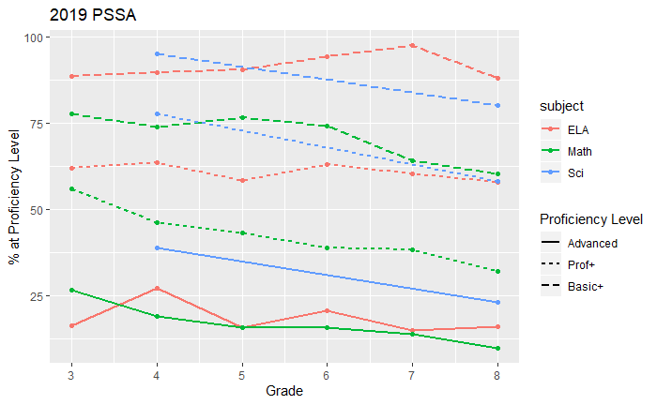

Slide 36
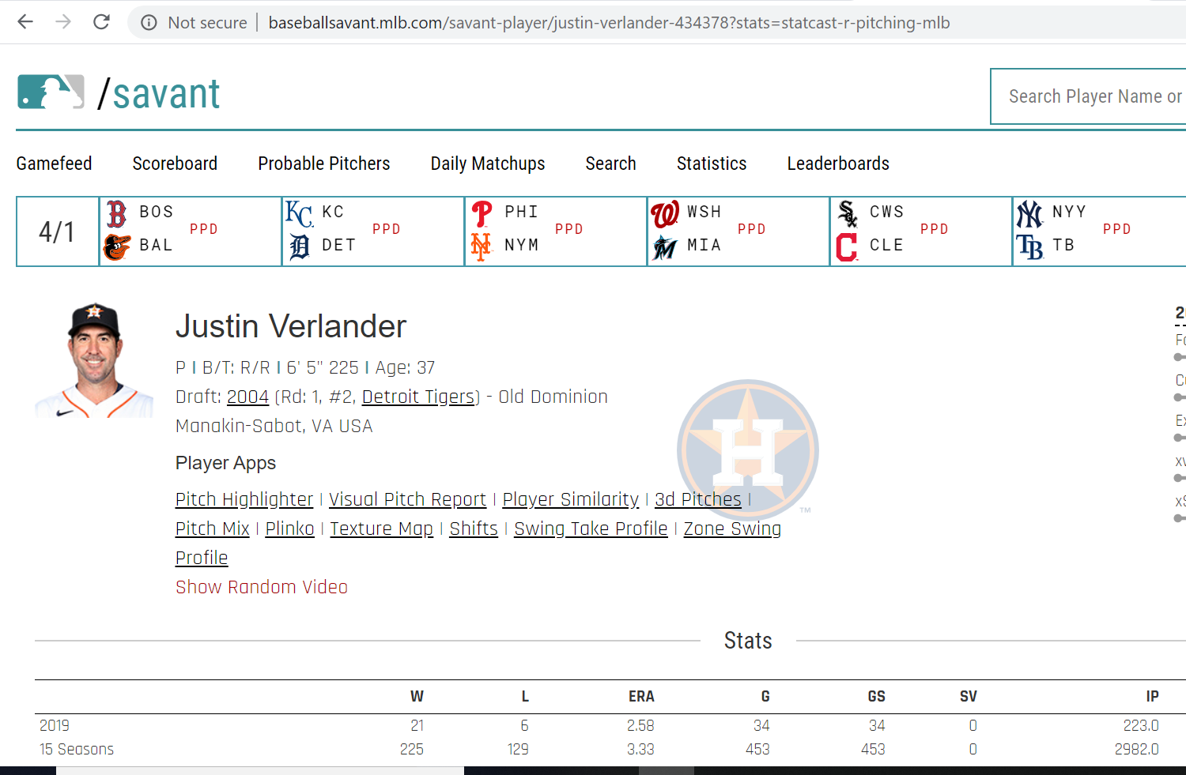
Data Scraping – Pitching Data
statcast_url %>%
read_html() %>%
html_nodes("table") %>%
pluck(i) %>%
html_table()
https://baseballsavant.mlb.com/savant-player/justin-verlander-434378?stats=statcast-r-pitching-mlb
Notes:
Danny Brace

Slide 37
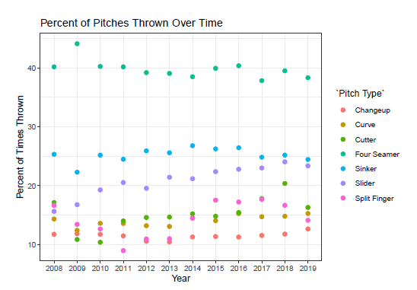
Data Scraping – Pitching Data
Get all 689 pitcher names from the website
pitch_arsenal_18<-pitch_arsenal_18_0 %>%
mutate(last_name= tolower(last_name),first_name= tolower(first_name)) %>%
unite(name_playerid,c("first_name","last_name","pitcher"),sep = "-")
scrape_savant_pitch_tracking <- function(name_playerid){
statcast_url <- paste0("https://baseballsavant.mlb.com/savant-player/",+
name_playerid, "?stats=statcast-r-pitching-mlb")
temp_df <- statcast_url %>%
read_html() %>%
html_nodes("table")
for(i in 1:length(temp_df))
{temp_df2 <-temp_df %>%
.[[i]] %>%
html_table() %>%
as.data.frame()
ifelse(colnames(temp_df2[2])=="Pitch Type",permenant_df0 <- temp_df2,0)
}
permanent_df<-permenant_df0 %>%
mutate(pitcher_id = name_playerid) %>%
separate(pitcher_id,c("first_name","last_name","playerid"),sep="-") %>%
select(first_name,last_name,playerid,Year:`PutAway%`)
return(permanent_df)
}
Create a list the URL to scrape for pitcher data
Grab the data from each table
Check if it follows the desired format
Save it to a permanent file
Notes:
Danny Brace

Slide 38
Data Scraping – Zip Codes (SAS MP)
zip15003 <- "https://www.zip-codes.com/zip-code/15003/zip-code-15003.asp"
thisURL <- zip15003
read_zip_url <- function(thisURL) {
this_zip <-
thisURL %>% read_html() %>% html_nodes("table") %>% pluck(1) %>% html_table(fill=T) %>% as_tibble() %>%
select(1:2) %>%
filter(X1 %in% c("Zip Code:","City:","State:","City Alias(es):","City
Type:","Classification:","Latitude:","Longitude:","County FIPS:","Intro Date:", "Current
Population:","Households per ZIP Code:","Average House Value:","Avg. Income Per
Household:","Median Age:", "# Residential Mailboxes:","# Business Mailboxes:"))
thisZip0 <- data.frame(t(this_zip %>% select(2)))
names(thisZip0) <- t(this_zip %>% select(1))
thisZip <- thisZip0[,1:17]
return(thisZip)
}
read_zip_url(zip15003)

Slide 39
Selector Gadget
Available for Google Chrome at bit.ly/SelectorGadget
There is a tutorial video and a bookmarklet version available at http://selectorgadget.com
Selector Gadget is an open source Chrome Extension that makes CSS selector generation and discovery on complicated sites a breeze.
CSS is Cascading Style Sheets – describes how HTML elements are displayed
After having installed the extension, go to any page and launch it. A box will open in the bottom right of the website. Click on a page element that you would like your selector to match (it will turn green). SelectorGadget will then generate a minimal CSS selector for that element, and will highlight (yellow) everything that is matched by the selector. Now click on a highlighted element to remove it from the selector (red), or click on an unhighlighted element to add it to the selector. Through this process of selection and rejection, SelectorGadget helps you come up with the perfect CSS selector for your needs.

Slide 40
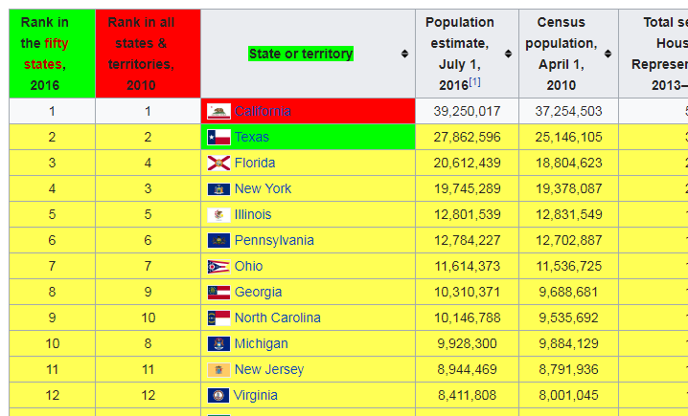

Slide 41
xpath
If you know the xpath syntax, you can enter that directly:
html_node(document,
xpath = "//h1/following-sibling::p/following-sibling::p“)

Slide 42
Reading Twitter Data Using TwitteR
API or Application Programming Interface
Allows users to access data that’s “behind the scenes” of websites
Is allowed by website owner
For Twitter, there is a twitteR package
You need to set up your Twitter API. Here is the URL with instructions (it’s on the website as well).
setup_twitter_oauth(consumer_key="",consumer_secret="",access_token="",access_secret = "")
Notes:
Hold off on this until we get to working with strings!

Slide 43
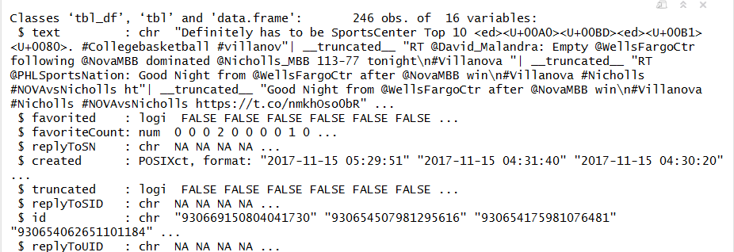
Reading Tweets from Twitter
VU_tweets <- searchTwitter("#Villanova",lang="en",n=1000,retryOnRateLimit=100)
VUt <- as.tbl(twListToDF(VU_tweets))
str(VUt)
Notes:
ADD A SECTION ON WORKING WITH STRINGS (FROM TEXT MINING)

Slide 44
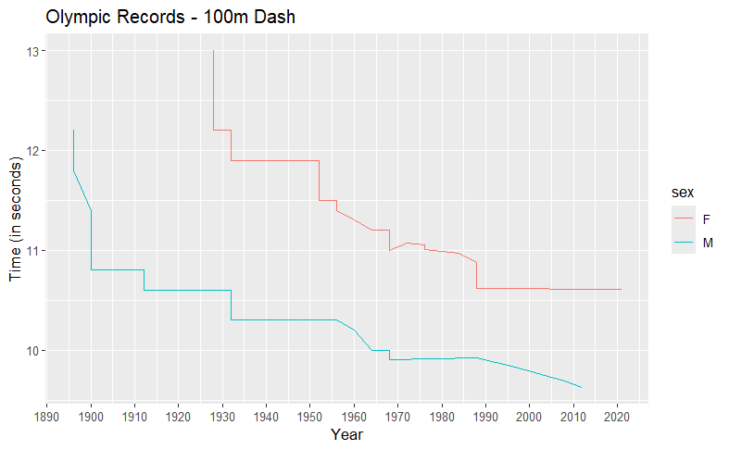
Your Turn
Scrape the 100m Olympic record progression data to create the following graph:
https://en.wikipedia.org/wiki/100_metres_at_the_Olympics
Note: I used the following to parse out the times:
separate(Time,into=c("time","time_words"), sep= " ")
Notes:
Start here on 10/22 – do review of scraping, continue here, make sure they can do everything for the project

Slide 45
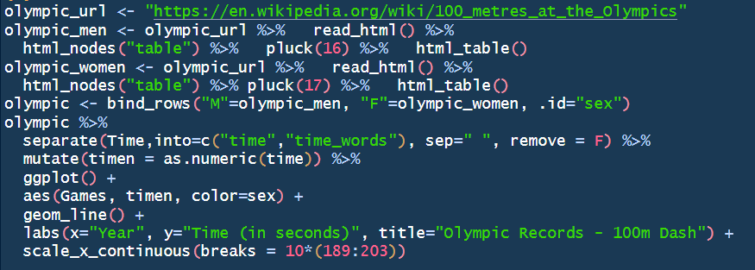
Your Turn – Solutions
Notes:
library(tidyverse)
library(rvest)
olympic_url <- "https://en.wikipedia.org/wiki/100_metres_at_the_Olympics"
olympic_men <- olympic_url %>% read_html() %>% html_nodes("table") %>% pluck(16) %>% html_table()
olympic_women <- olympic_url %>% read_html() %>% html_nodes("table") %>% pluck(17) %>% html_table()
olympic <- bind_rows("M"=olympic_men, "F"=olympic_women, .id="sex")
olympic %>%
separate(Time,into=c("time","time_words"), sep=" ", remove = F) %>%
mutate(timen = as.numeric(time)) %>%
ggplot() + aes(Games, timen, color=sex) + geom_line() +
labs(x="Year", y="Time (in seconds)", title="Olympic Records - 100m Dash") +
scale_x_continuous(breaks = 10*(189:203))

